Slide 1
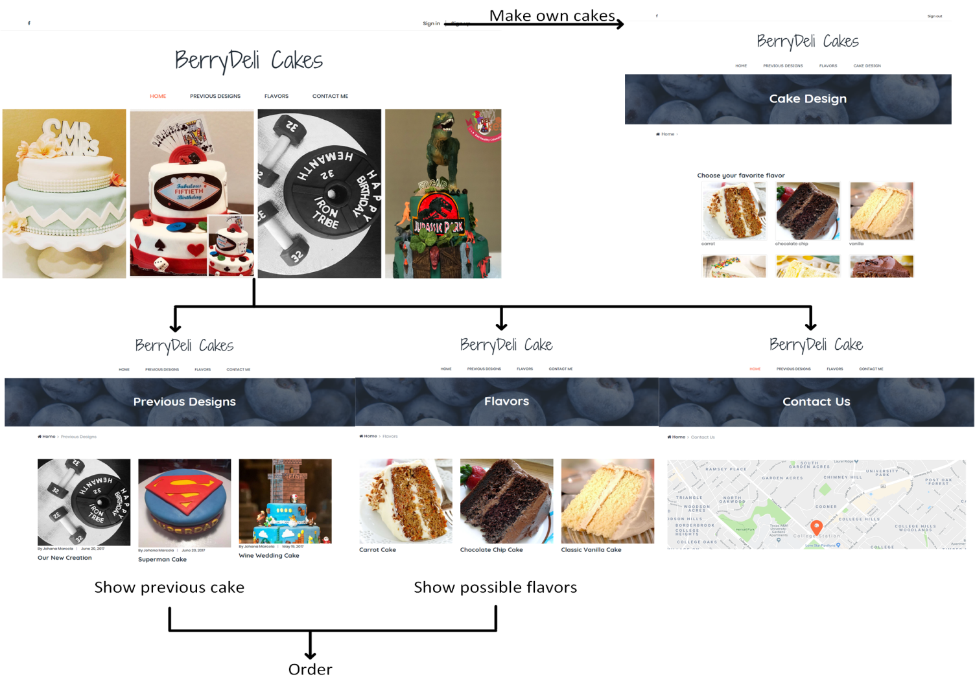
Make your cakes! BERRYDELI CAKES

